Slide 1
WOMEN VS. CANCER
By: Kalaya B, Ashlyn J, Prama M, Emily S, & Karolina V.

Slide 2
Introduction
This project will display the different types of cancer found specifically in women and ways to prevent it.

Slide 3
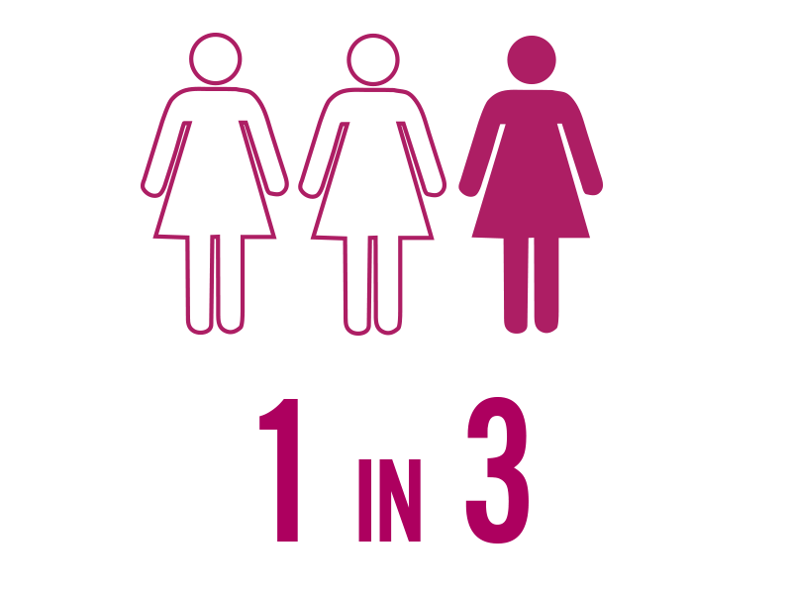
What is Cancer?
It affects about 1 out of 3 people
100+ types of cancer
Median age of a cancer diagnosis → 66
Estimated 1,762,450 new cancer cases diagnosed and 606,880 cancer deaths in US during 2019

Slide 4
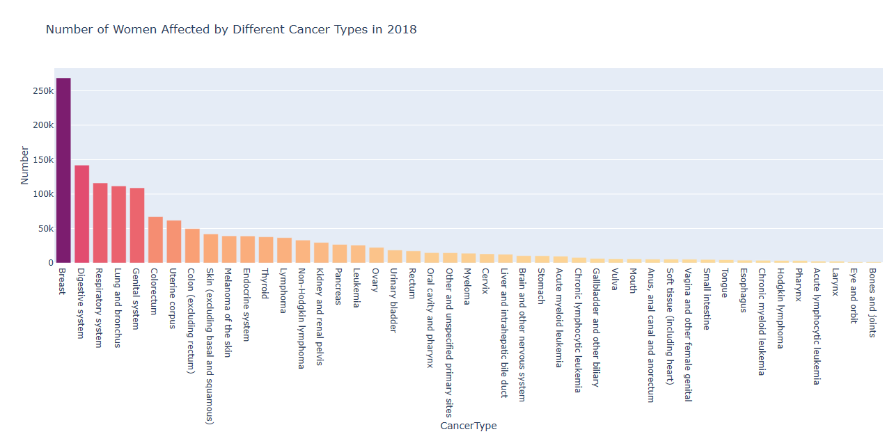
Data Analysis

Slide 5


Women VS. Breast Cancer Facts:
Breast cancer is the most common cancer in women.
Each year, about 40,000 lives are lost to breast cancer.
1 in 8 women will be diagnosed with breast cancer
Death rates from breast cancer have been on the decline since 1990, due to early detection.

Slide 6

Sophia Anagnostou’s Cancer Story
Sophia was diagnosed with Leukemia when she was 12.

Slide 7
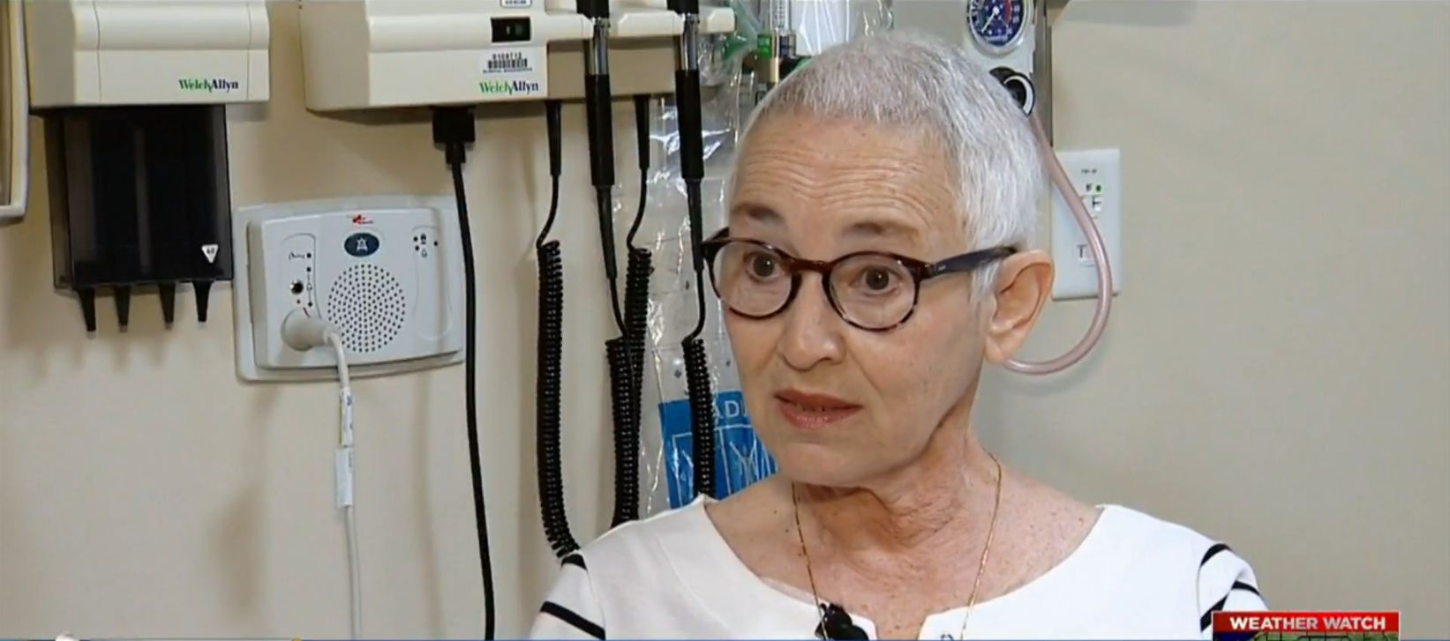
Darlene Bossola’s Cancer Story
70-year old Darlene has been diagnosed with stage three pancreatic cancer.

Slide 8

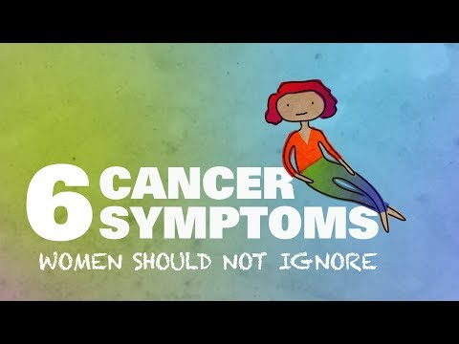
Cancer Symptoms for Women

Slide 9
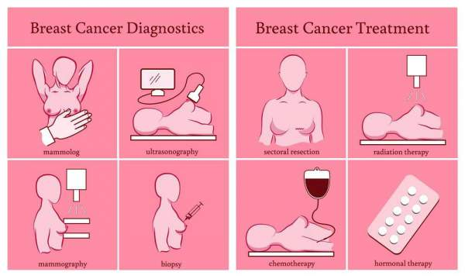
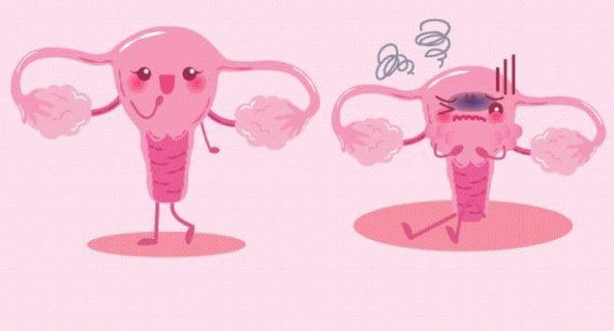
Conclusion
TOP 4 WAYS TO REDUCE CANCER RISKS
Don’t smoke or use any tobacco products.
Minimize alcohol intake. (For women, only have one drink a day or fewer.)
Don’t use supplements to try to protect against cancer (without doctor’s permission.)
Be physically active

Slide 10

Work Cited
Center, MD Anderson Cancer. “6 Cancer Symptoms Women Shouldn't Ignore.” YouTube, YouTube,
25 Apr. 2019, www.youtube.com/watch?v=nnk70FNGVBs.
“Childhood Leukemia Survivor Finds Beauty in Life.” American Cancer Society,
www.cancer.org/latest-news/childhood-leukemia-survivor-finds-beauty-in-life.html.
“Information and Resources about for Cancer: Breast, Colon, Lung, Prostate, Skin.” American Cancer
Society,www.cancer.org/.
“Lung Cancer.” Mayo Clinic, Mayo Foundation for Medical Education and Research, 16 Nov. 2018,
www.mayoclinic.org/diseases-conditions/lung-cancer/symptoms-causes/syc-20374620.
Nbcf. “Breast Cancer Facts :: The National Breast Cancer Foundation.” Www.nationalbreastcancer.org,
www.nationalbreastcancer.org/breast-cancer-facts.
“YOUR HEALTH: A New Way to Make a Direct Attack on Pancreatic Cancer Tumors.” WQAD.com, 31 July 2019,
wqad.com/2019/07/31/496107/.
“15 Ways to Reduce Your Cancer Risk.” Fred Hutch, 9 Jan. 2014,
www.fredhutch.org/en/news/center-news/2014/01/15-ways-to-reduce-your-cancer-risk.html?gclid=EAIaIQobChMIyZ

Slide 11
Thank you for your time.

